Slide 1
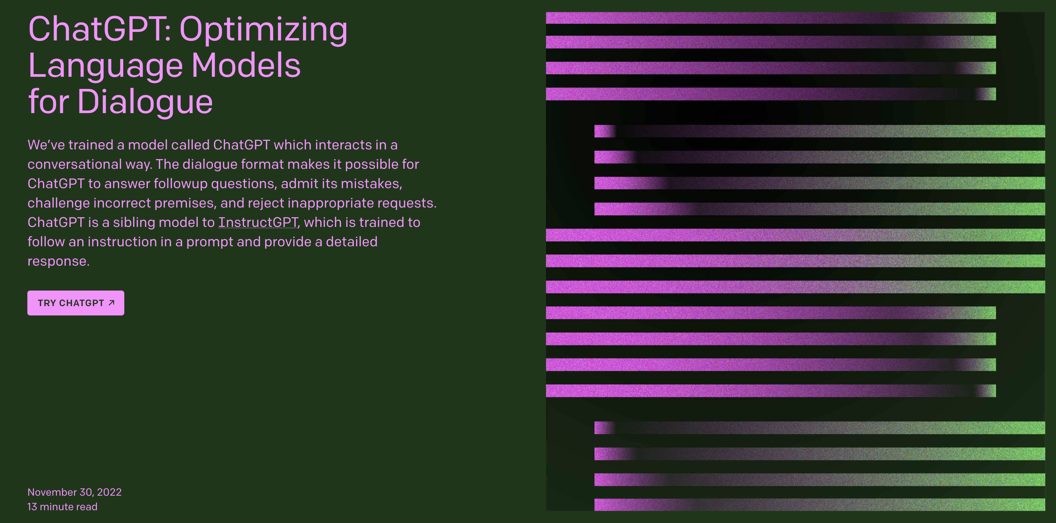
ChatGPT
How it works
Presented by: John Tan Chong Min

Slide 2


What comes next?
Twinkle Twinkle Little ______
The wheels on the bus go round and _______

Slide 3

What comes next?
The best FIFA player is __________

Slide 4
We can do these in our brains.
Now how do we do these in a computer?

Slide 5
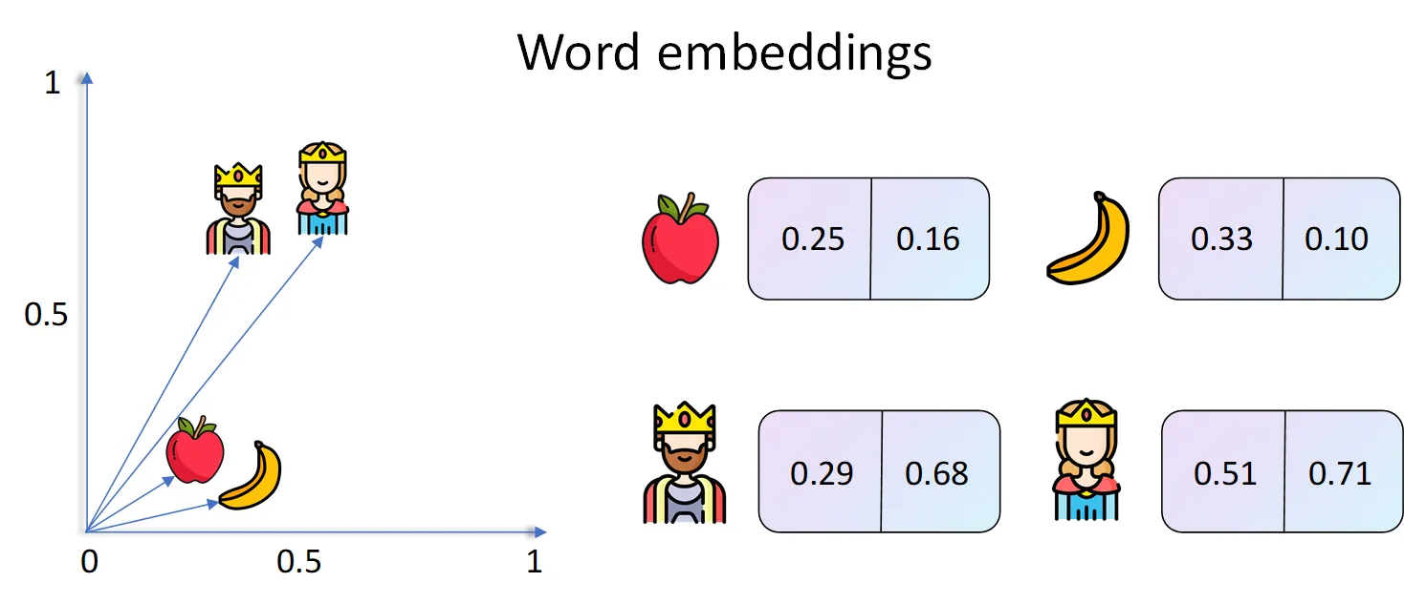
Word Embeddings
https://towardsdatascience.com/deep-learning-for-nlp-word-embeddings-4f5c90bcdab5

Slide 6

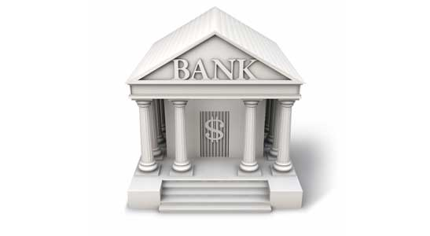
What is the meaning of this word?
Bank

Slide 7
We want to update meaning of each word iteratively
Mary went to the river bank

Slide 8
We want to update meaning of each word iteratively
Mary went to the river bank
Mary went to the river bank
Pay attention differently for each word!

Slide 9
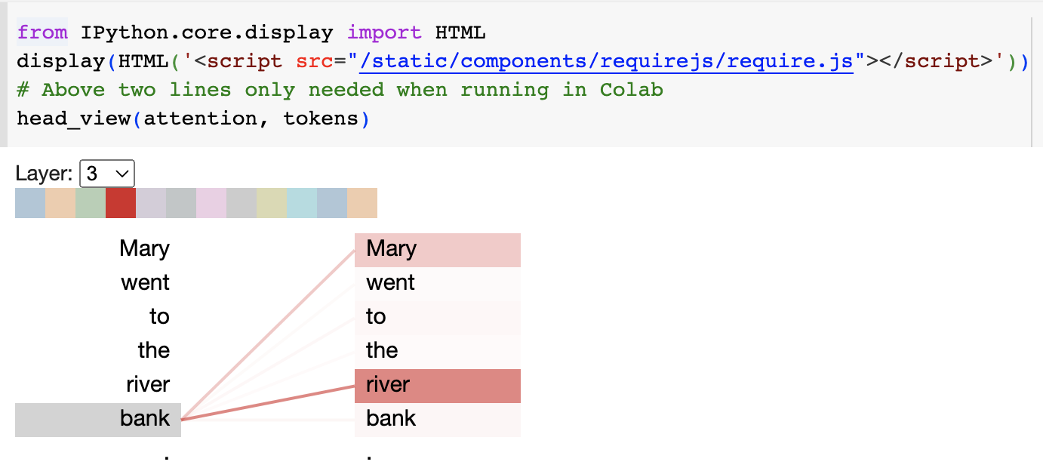
Visualizing what “bank” pays attention to

Slide 10
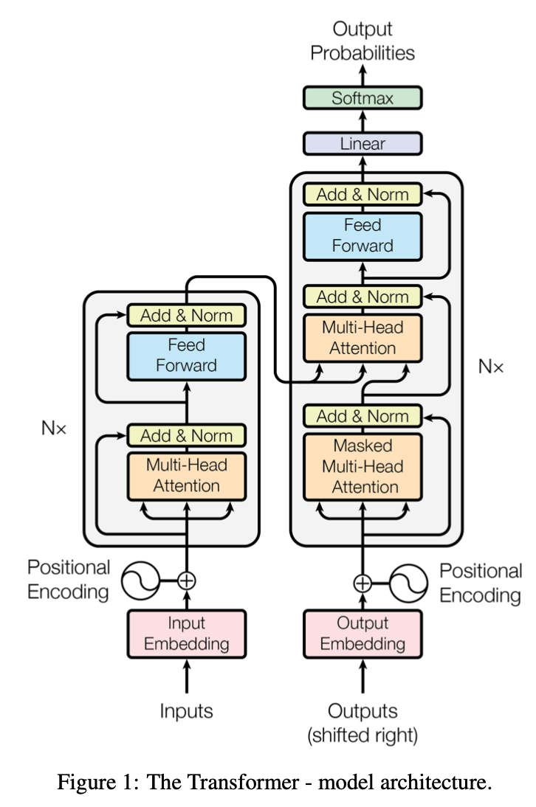
GPT generates differently each time!
Samples the next token according to the probability distribution
Example:
Input: Mary had a
Probability of next tokens: little (80%), big (20%)
Output: Mary had a little
Input: Mary had a little
Probability of next tokens: lamb (80%), dog (20%)
Output: Mary had a little lamb

Slide 11
Strengths of ChatGPT
Good for combining human knowledge in novel ways
Creative
Adaptable to small changes in input prompt
Great for coding and summarization
Good for doing homework requiring regurgitation of concepts
Can be a fun AI to chat with on any topic

Slide 12
Weaknesses of ChatGPT
Can give inconsistent output
Confident even when incorrect
Can be ambiguous and hedge multiple options even when there is one clear option
Not good at math (no longer any more with calculator functionality!)

Slide 13

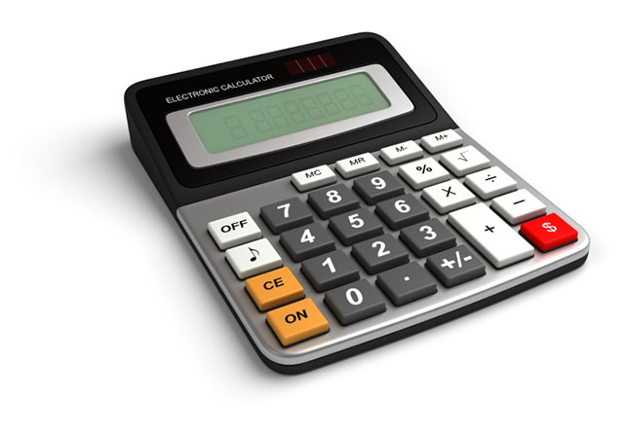


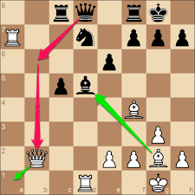


ChatGPT as an interface

Slide 14
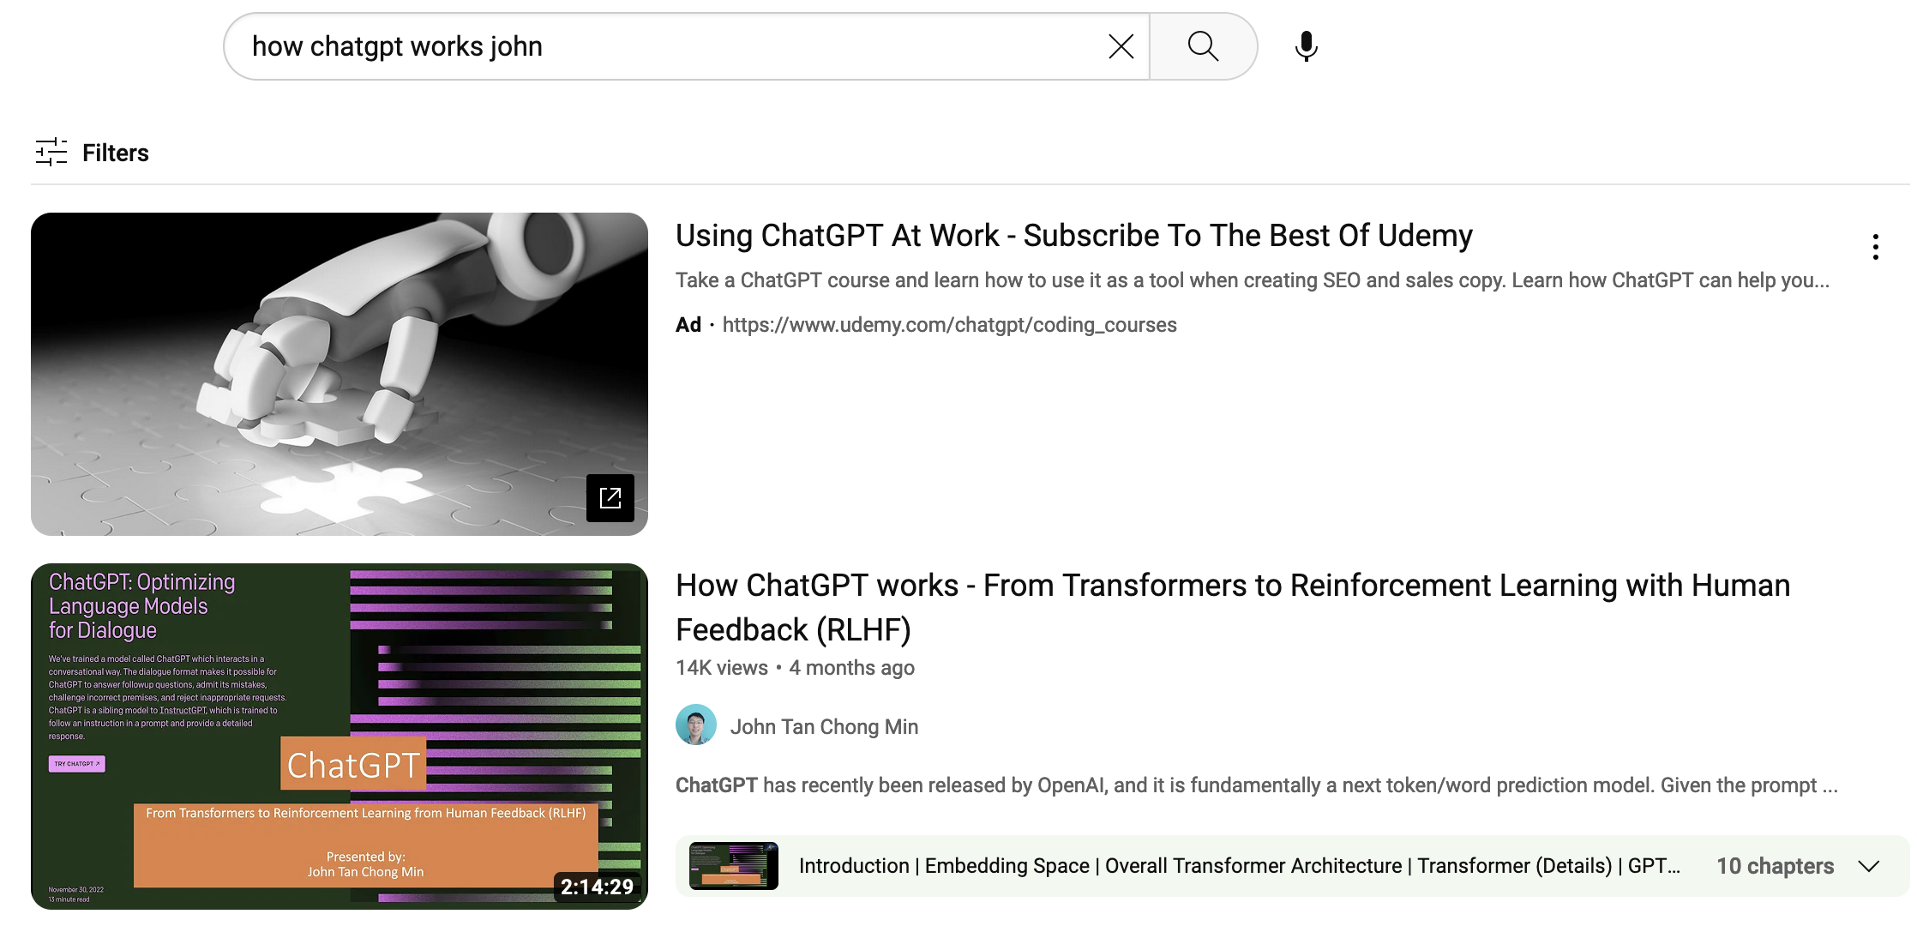
My own video on advanced explanation of ChatGPT

Slide 15
Discussion

